Slide 1
Iris Flower Prediction
Sidra Kousar Cosc222102010
Ayesha Shabbir Cosc222102018

Slide 2
Iris Flower
Machine Learning
"Machine learning is the process of training a machine using algorithms and data to predict outcomes. The more data provided, the more efficient the machine becomes in building prediction models. Increased data leads to better models and higher accuracy."
Supervised Learning
"Supervised learning involves training a machine learning model using labeled data. The model learns from both the features and their corresponding labels. This method utilizes a dataset where the desired outcomes are already known, making predictions about unseen data easier."

Slide 3
Iris Flower
Classification
Classification groups data into categories, and it's part of supervised learning. Understanding the dataset helps us find patterns. Using the Iris flower dataset, we predict iris plant types based on features like petal and sepal size. This dataset, created by Ronald Fisher, is widely used for classification tasks.
Dataset Overview
The Iris dataset, introduced by Ronald Fisher, has multiple features used for classification, such as petal and sepal size.

Slide 4
Iris Flower
Hardware Requirements
For classification, you'll need:
Processor: i3
RAM: 2 GB
Memory: 5 GB
Software and Libraries Requirements
To analyze the data, you'll need:
Python 3.7.2
Jupyter Notebook
sklearn
csv
numpy
pandas
matplotlib

Slide 5
Iris Flower
Iris Flower Prediction Project
Welcome to the Iris Flower Prediction project! We're leveraging computers to identify iris flowers based on their unique features. This has implications for understanding nature and improving plant care. Our objective is to develop precise programs for recognizing iris species. Join us as we delve into iris flowers and machine learning!

Slide 6
Iris Flower
Training and Testing
In our Iris Flower Prediction project:
Training Data: This is where we teach our models. It's a part of our dataset with known iris flower types. Our algorithms learn patterns from this.
Testing Data: Here, we check how well our trained models work. It's a set of new examples the model hasn't seen before. We use it to see if our model can accurately predict iris flower types.

Slide 7
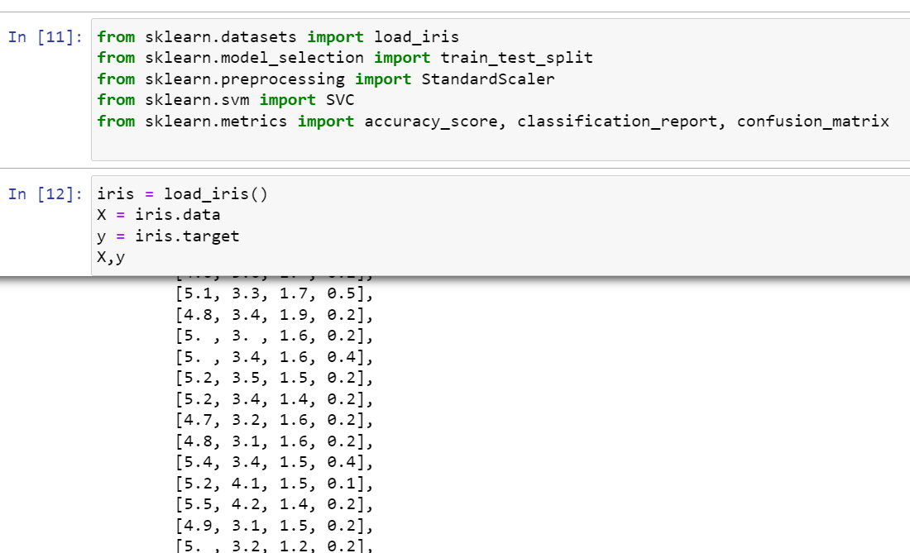
Code of Iris Flower

Slide 8
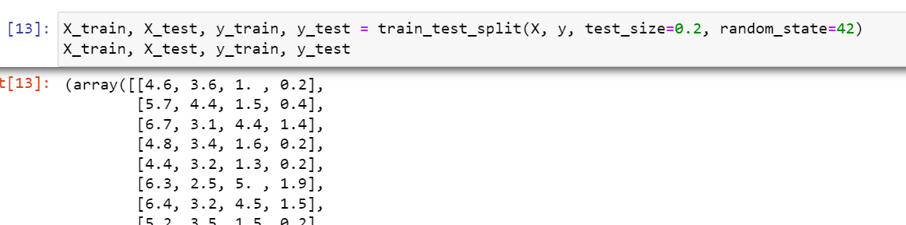
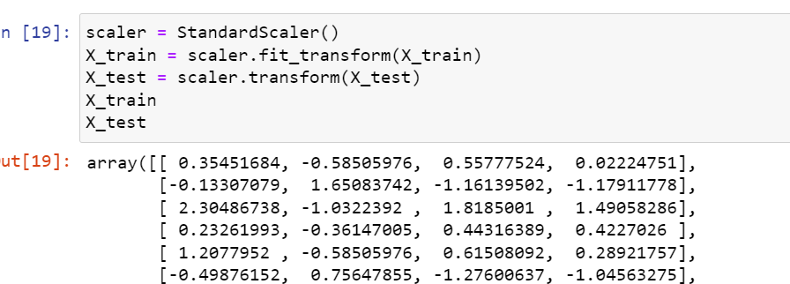

Slide 9
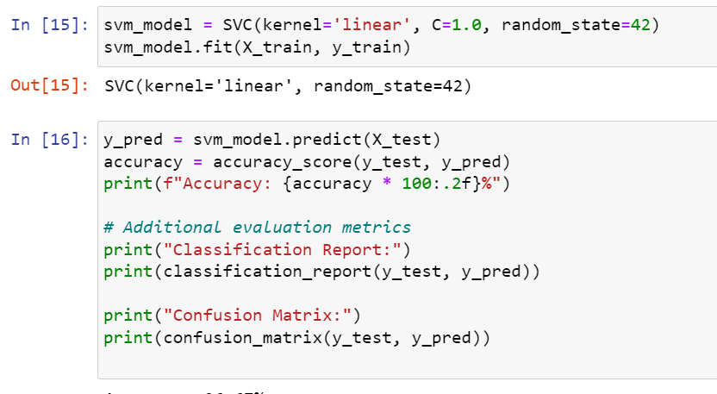
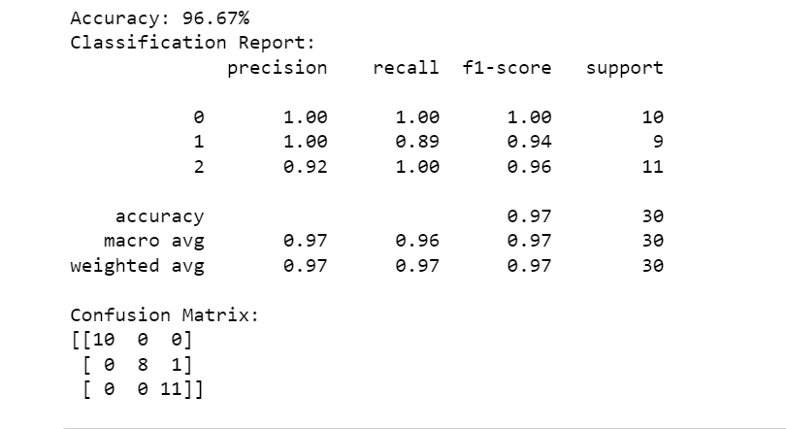

Slide 10
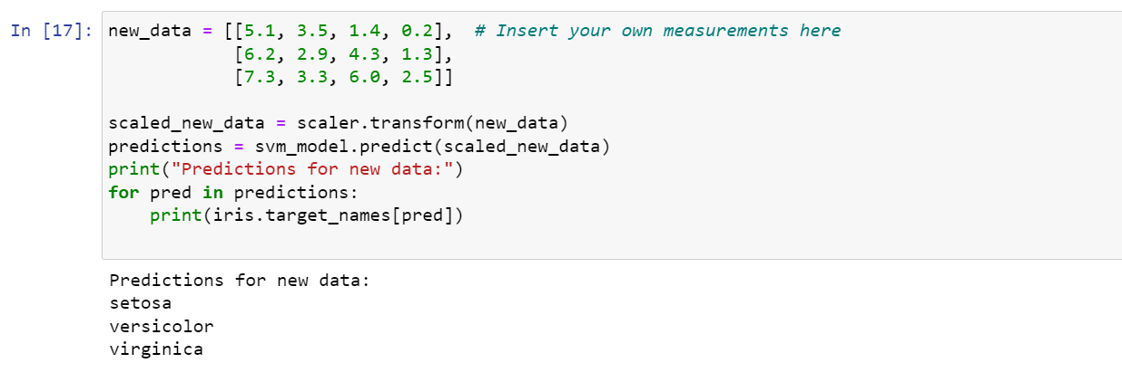
Result

Slide 11
Iris Flower
Importance of Iris Flower Prediction
Predicting iris flower species aids scientists, gardeners, and plant enthusiasts. It enhances botanical knowledge, assists in breeding programs, and optimizes plant care. Additionally, it's a captivating educational activity, deepening understanding of plant diversity.

Slide 12
Iris Flower
Collect Data: Gather information on iris flowers' characteristics for analysis.
Analyze Data: Understand patterns using numbers and graphs.
Train Models: Teach computers to recognize iris flower types based on the data.
Test Models: Evaluate model accuracy with new data.
Share Insights: Discuss findings and potential applications in botany and beyond.

Slide 13
Iris Flower
Iris Data Overview
The dataset used in this project is sourced from the UCI Machine Learning Repository. Known as the Iris flower dataset or Fisher's Iris dataset, it comprises multivariate data.
Sample Composition: The dataset includes 50 samples from each of three Iris species: Iris virginica, Iris versicolor, and Iris setosa.
Features: Each sample is characterized by four measured features, all in centimeters:
Length of petals
Width of petals
Length of sepals
Width of sepals

Slide 14
Iris Flower
Conclusion
The Iris Flower Prediction project successfully integrates botany and machine learning, improving iris flower identification through data analysis. By training computer models on the UCI Iris dataset, we can accurately classify iris species based on their unique features. This approach demonstrates technology's potential to advance botanical research and conservation efforts.

Slide 15
Different Flower Prediction
This code snippet is a Python script that reads images from a directory containing subdirectories, each representing a different category of flowers. It then displays sample images from each flower category.
Reading Images: The script iterates through each subdirectory (flower category) and reads all image files within it using OpenCV. It converts the images from BGR to RGB format, which is more commonly used.

Slide 16
Different Flower Prediction
Storing Images and Labels: It stores the images and their corresponding labels (flower categories) in separate lists.
Displaying Sample Images: For each unique flower category, it displays a set number of sample images (specified by num_samples_per_category) along with their labels.
This script provides a visual overview of the dataset, helping to understand the images and their associated categories.

Slide 17
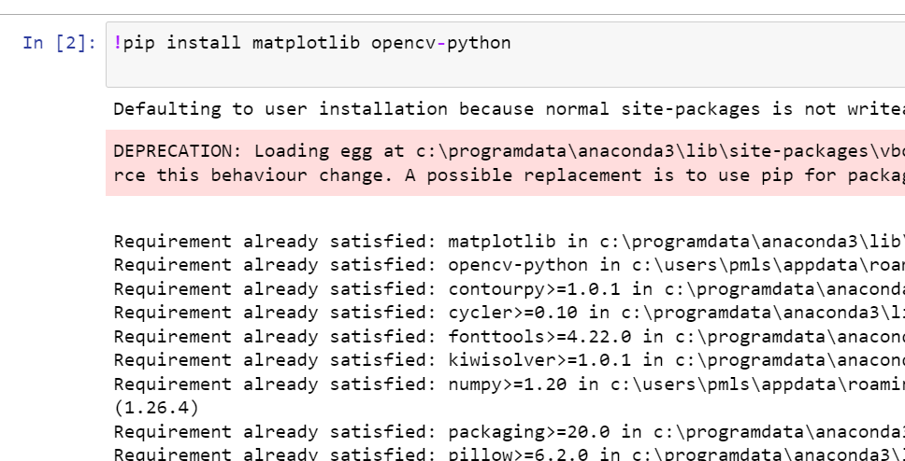
Code of Different Flower Prediction

Slide 18
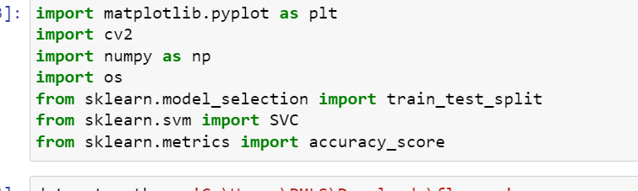
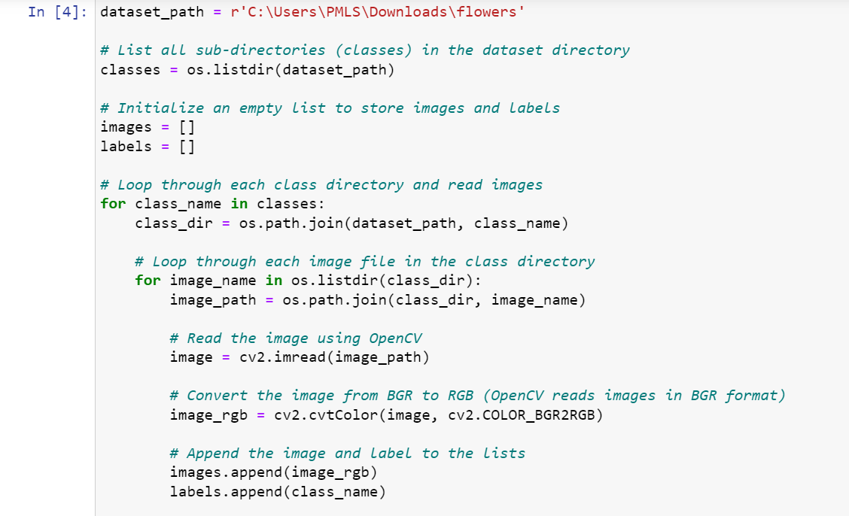

Slide 19
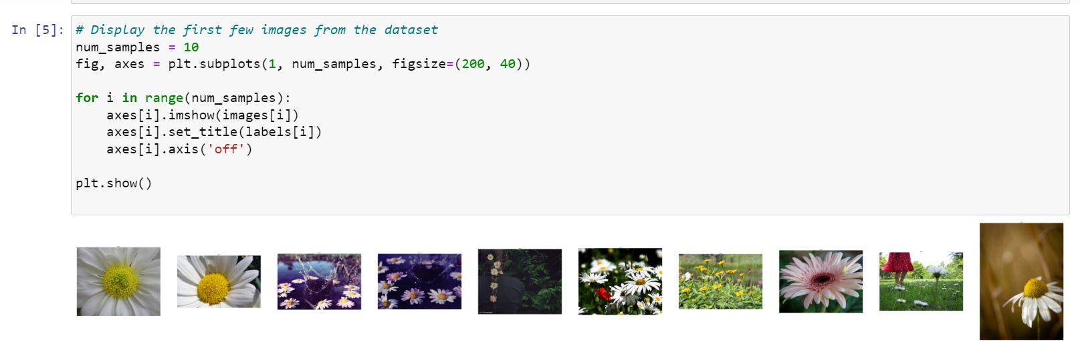

Slide 20
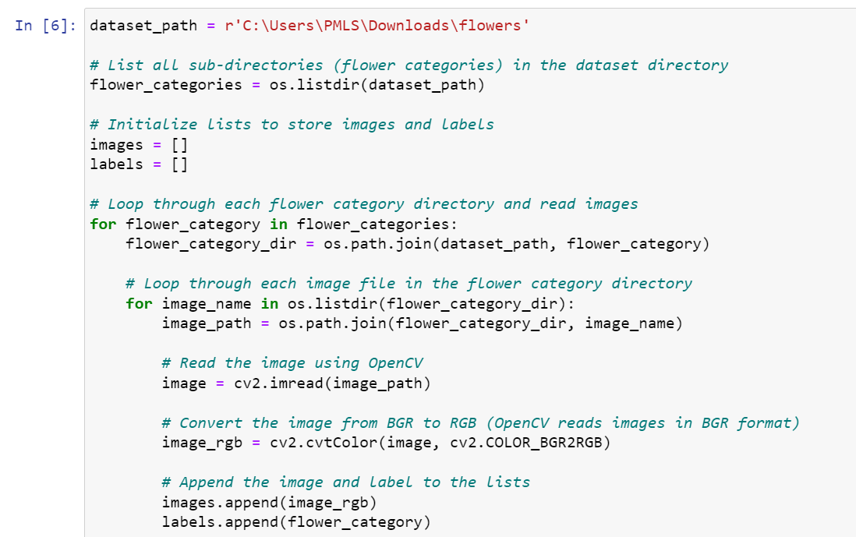

Slide 21
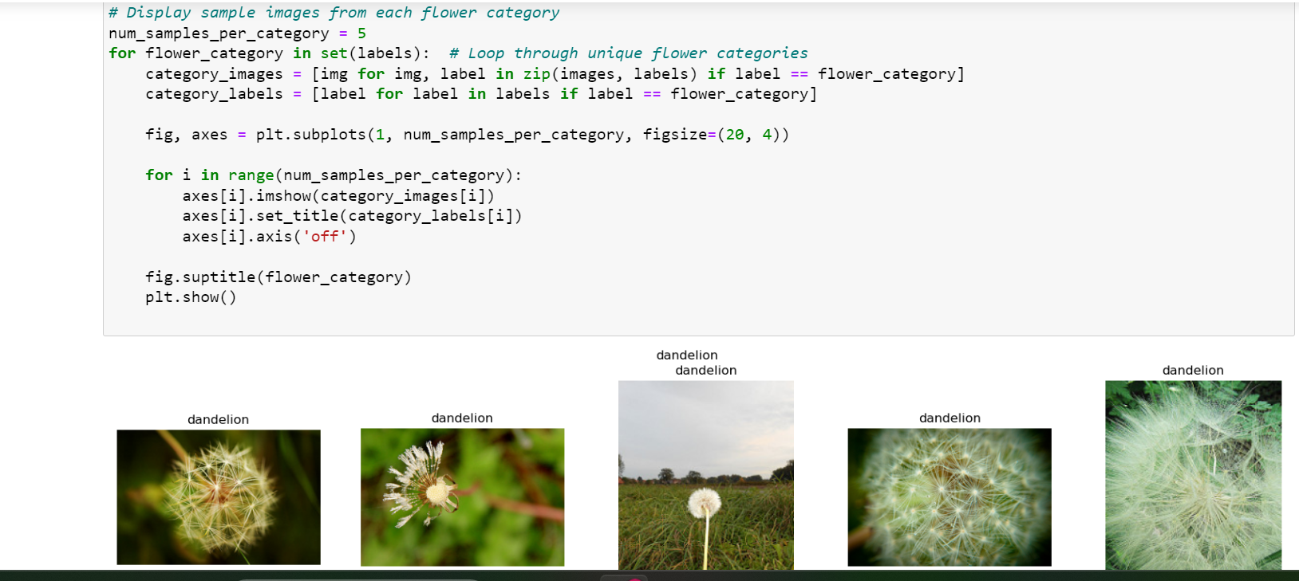

Slide 22
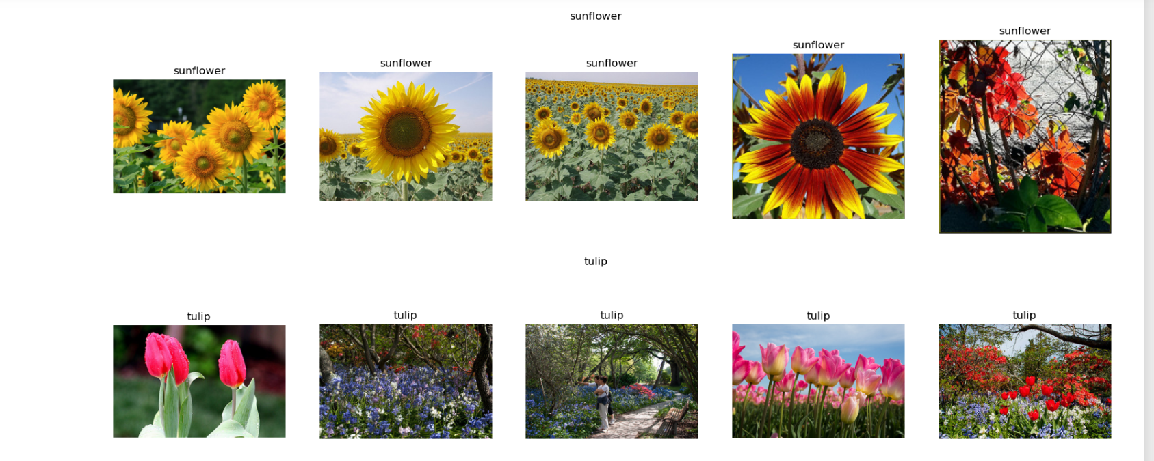

Slide 23
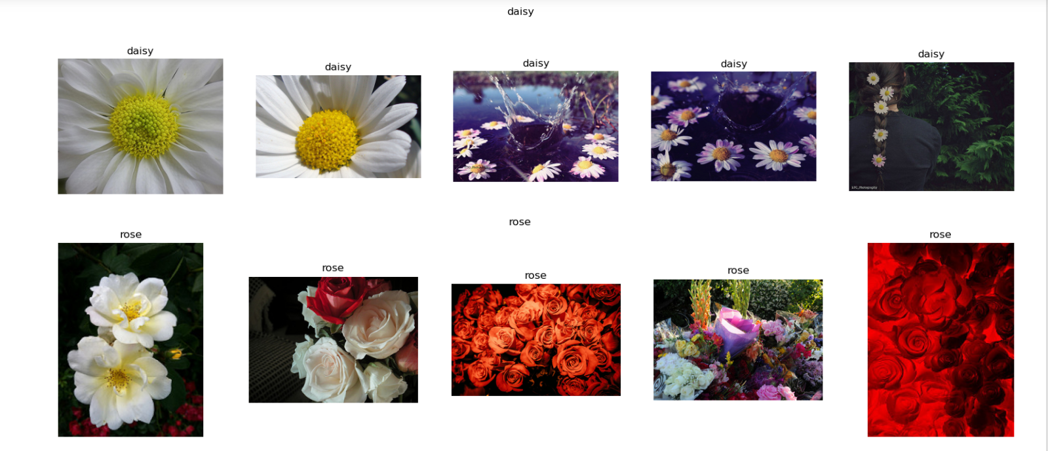

Slide 24


